Slide 2
Risk, Operations & Resiliency

Slide 3
Risk, Operations & Resiliency
5.4 Summarize risk management processes and concepts
2.5 Given a scenario, implement cybersecurity resilience

Slide 4
5.4 Summarize risk management processes and concepts
Risk Management Processes
Identify mission essential functions
Identify vulnerabilities
Identify threats
Analyze business impacts
Identify risk response
Risk assessment
Likelihood and impact
Enterprise risk management (ERM) frameworks
Risk and control self-assessment (RCSA)
Risk and control assessment (RCA)

Slide 5
5.4 Summarize risk management processes and concepts
Risk Types
External
Cyber threat actors and natural or person-made disaster
Internal
Risks that arise from assets that are owned/managed
Multiparty
Ripple impacts in the supply chain
Intellectual property (IP) theft
Software compliance/licensing
Shadow IT
Legacy systems

Slide 6
5.4 Summarize risk management processes and concepts
Quantitative versus qualitative assessments
Quantitative
Concrete values to risk factors ($$$)
Single Loss Expectancy (SLE)
Exposure Factor (EF)
Annualized Loss Expectancy (ALE)
Annualized Rate of Occurrence (ARO)
Difficulty of forecasting likelihood
Difficulty of assessing impact/cost

Slide 7

5.4 Summarize risk management processes and concepts
Quantitative Risk Assessment
First steps
Identify assets and Asset Value
Asset Value (full cost of asset)
Loss
Identify or calculate the single loss expectancy (SLE)
If there is less than a 100% loss, calculate the SLE
SLE = AV x EF
SLE = Asset Value (full cost of asset) x Exposure Factor (% of asset lost)
Annual Rate of Occurrence (ARO)
How many times the loss will occur annually
ARO = ALE / SLE
Annual Loss Expectancy (ALE)
ALE= SLE * ARO

Slide 8
Scenarios
You own a trucking company and a fleet of trucks. The trucks cost $130,000 each. You have good truckers, but there are still five accidents per year. With each accident, there is a 35% loss. What is your annual loss expectancy (ALE)?
You own a fleet of fishing boats. Each boat costs $60,000. Unfortunately, due to bad weather, two boats sink every year resulting in a 100% loss. What is your annual loss expectancy (ALE)?
You own a bicycle shop. You do a very good business, but you lose a dozen bicycles about every two years due to theft. Each bike costs $800. What is your annual loss expectancy (ALE)?
Notes:
SLE=130,000 x .35; ALE=45,500 x 5; ALE= $227,500
ALE= $120,000
ALE= $4,800

Slide 9
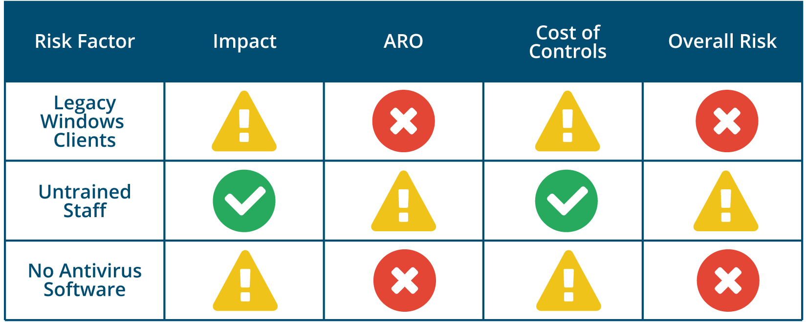
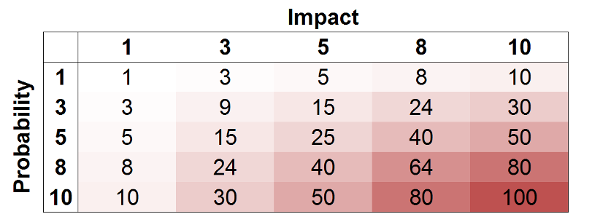
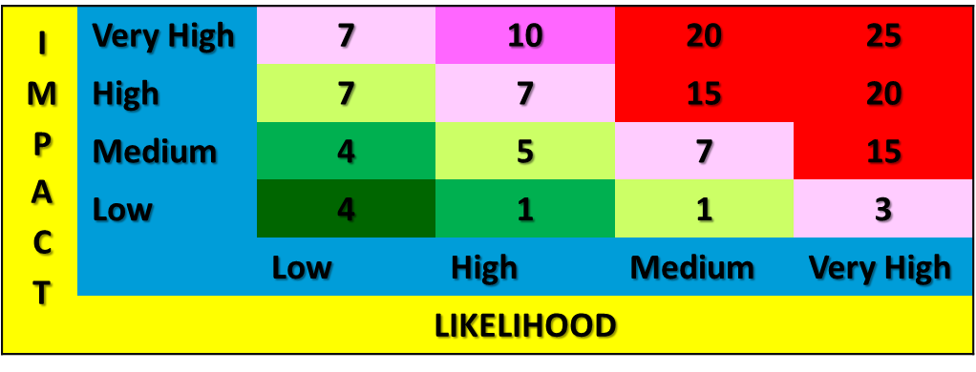
5.4 Summarize risk management processes and concepts
Qualitative Risk Assessment
Seeks opinions and uses broad categorizations
Heat map or traffic light impact matrix
Security Categorizations (FIPS 199)
Low
Medium
High
Risk matrix/heat map
Used to get a visual representation of the risks affecting a company
Shows the severity of the situation
Most severe risks being in RED
PINK would still mean a high risk
LIGHTER PINK and GREEN would mean a medium risk
DARKER GREEN and the VERY DARK GREEN would mean a low risk
Notes:
FIPS 199- FEDERAL INFORMATION PROCESSING STANDARDS PUBLICATION
(nvlpubs.nist.gov/nistpubs/FIPS/NIST.FIPS.199.pdf) discusses how to apply security categorizations (SC) to information systems based on the impact that a breach of confidentiality, integrity, or availability would have on the organization as a whole. Potential impacts can be classified as:
Low—minor damage or loss to an asset or loss of performance (though essential functions remain operational).
Moderate—significant damage or loss to assets or performance.
High—major damage or loss or the inability to perform one or more essential functions.

Slide 10
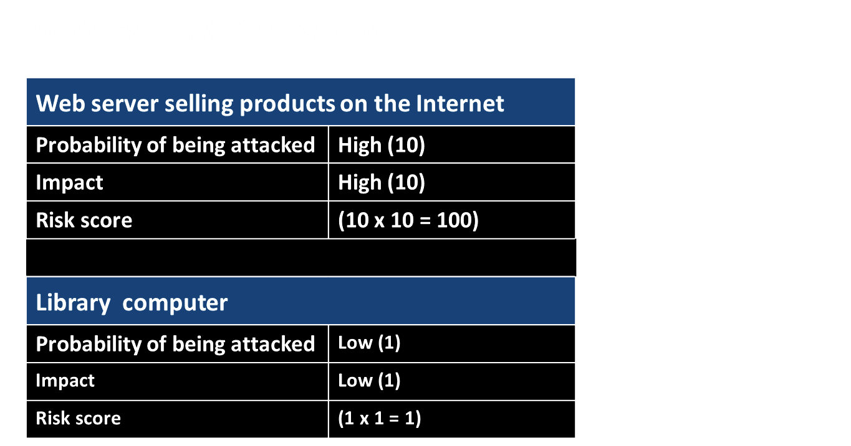
Summarize risk management processes and concepts

Slide 11
5.4 Summarize risk management processes and concepts
Risk Management Strategies
Inherent Risk
Level of risk before any type of mitigation has been attempted
Risk posture and prioritization
Regulatory requirements
High value asset, regardless of threat likelihood
Threats with high likelihood
Procedures, equipment, or software that increase the likelihood of threats
Return on Security Investment (ROSI)
Risk Mitigation / remediation
Deploy countermeasure
Reduce likelihood or impact or both

Slide 12
5.4 Summarize risk management processes and concepts
Risk Avoidance and Risk Transference
Risk Avoidance
Not participate in risky activity
Risk Transference
Sometimes referred to as sharing risk
Insurance of any kind, whether it is for a car or for cybersecurity, is risk transference
Risk mitigation is a technical control
Configuring the mail server to prevent spear phishing attacks through email messages
Technical solution for identity management, an architect chooses to go from an in-house solution to a third-party SaaS provider

Slide 13
5.4 Summarize risk management processes and concepts
Risk Acceptance and Risk Appetite
Risk Acceptance/Tolerance
Risk is assessed and monitored, but no countermeasure is put in place
Use if cost of control greater than the benefit
Do not ignore risk
Residual Risk
Likelihood and impact after mitigation
Risk Appetite
Willingness to tolerate a certain level of risk
Established at an organization or project level
Control Risk
Loss of countermeasure effectiveness over time
Evaluate whether it is still effective

Slide 14
5.4 Summarize risk management processes and concepts
Risk Awareness
Communicate risk factors to stakeholders
Risk registers
A record of information about identified risks including information about
Specific risks
Likelihood and impact
Security controls
contingencies
Risk matrix/heat map
Graphs
Relevance to workflows

Slide 15
Answer the questions…
Which of the following risk management strategies would include the purchase and installation of an NGFW?
Transference
Mitigation
Acceptance
Risk Avoidance
Which of the following describes a monetary loss if one event occurs?
ALE
SLE
RTO
ARO
Notes:
Answers
1. The Answer: B. Mitigation
Mitigation is a strategy that decreases the threat level. This is commonly
done through the use of additional security systems and monitoring, such
as an NGFW (Next-Generation Firewall).
The incorrect answers:
A. Transference
Transference would move the risk from one entity to another. Adding an
NGFW would not transfer any risk to another party.
C. Acceptance
The acceptance of risk is a position where the owner understands the risk
and has decided to accept the potential results.
D. Risk-avoidance
With risk-avoidance, the owner of the risk decides to stop participating in
a high-risk activity. This effectively avoids the risky activity and prevents
any future issues.
2. The Answer: B. SLE
SLE (Single Loss Expectancy) describes the financial impact of
a single event.
The incorrect answers:
A. ALE
ALE (Annual Loss Expectancy) is the financial loss over an entire
12-month period.
C. RTO
RTO (Recovery Time Objectives) define a set of objectives needed to
restore a particular service level.
D. ARO
The ARO (Annualized Rate of Occurrence) is the number of times an
event will occur in a 12-month period.

Slide 16

QUESTIONS?

Slide 17

5.4 Summarize risk management processes and concepts
Business impact analysis (BIA) reports for threat scenarios
Calculate impact as costs
Justifies and prioritizes investment in security controls
Business continuity planning/continuity of operations planning (COOP)
Identifies controls and processes that maintain critical workflows
BIA
Mission Essential Functions
Critical Systems
Asset Value Prioritization
SPoF
MTD
RTO
WRT
RPO
MTTR
MTBF
MTTF
Recovery Strategies
Continuity of Operations
Hot Site
Warm Site
Cold Site
Cloud based Site
Plan Development
Disaster Recovery Plan (DRP)
Respond
Activate Recovery Team
Communications
Assessment & Recovery
Testing & Exercises
Walkthroughs
Tabletop Exercises
Functional Exercises
Full Scale Exercises
Notes:
Contrast the impact analysis activity with the continuity analysis activity. Impact analysis prioritizes investment in continuity.

Slide 18
5.4 Summarize risk management processes and concepts
Business impact analysis (BIA)
Prioritizes a company’s most valuable assets when evaluating the impact:
Will a disaster result in loss of life?
Will a disaster result in loss of property?
Will a disaster reduce safety for personnel?
What are the potential financial losses to the organization?
What are the potential losses to the organization’s reputation
Process for determining how a disruption to the IT systems of an organization will impact the organization's requirements, processes and interdependencies

Slide 19
5.4 Summarize risk management processes and concepts
Business Impact Analysis
Maximum Tolerable Downtime (MTD)
Is the longest period that a business function can outage may occur for without causing irrecoverable business failure
Recovery Point Objective (RPO)
RPO is how much time a company can last without its data before it affects operations
This is also known as acceptable downtime

Slide 20
5.4 Summarize risk management processes and concepts
Business Impact Analysis
Recovery Time Objective (RTO)
Maximum amount of time a mission essential function can operate without the critical systems it depends on before significantly impacting the organization
RTO for critical systems identified in a company’s Disaster Recovery Plan (DRP)
Also know as Return to Operational State
Time it takes for the company to return to an operational state
Work Recovery Time (WRT)
Is the time needed to configure a recovered system
RTO +WRT must not exceed MTD
Single Point of Failure (SPoF)
Is any single component that would prevent a company from remaining operational
Most critical aspects of BIA

Slide 21
5.4 Summarize risk management processes and concepts
Business Impact Analysis
Mean Time to Repair (MTTR)
Average time it takes to repair a system
Could be seen as the time to repair a system and not the average time
Term used to restore a system to its operational state
Mean Time Between Failures (MTBF)
Measure of reliability
Mean Time to Failure (MTTF)
Average life span

Slide 22
5.4 Summarize risk management processes and concepts
Business Impact Analysis
Mission Essential Functions
Business activities that cannot be deferred
If this was to fail, it would result in LOSS of:
Revenue
Referrals
Reputation
Mission Critical Systems
Systems necessary to perform essential functions and activities
A critical enterprise component whose loss or destruction would:
Significantly IMPEDE business operations
Have an outsized IMPACT on corporate revenue

Slide 23


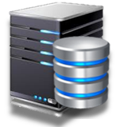
5.4 Summarize risk management processes and concepts
Business Impact Analysis
Mission Essential Functions & Critical Systems
Example, Airline website to sell airline tickets
Mission Essential Function
Web server
Server that the website was placed on to contact a backend database server
Critical systems
Database server
That holds ticketing information
Processes credit card transactions
Contains the order history for each customer

Slide 24
5.4 Summarize risk management processes and concepts
Disasters
Internal Threat vs External Threat
Internal- malicious activity or accident by employee or contractor (or accidental)
External- threat actors who have privileged access, social impact
Person-made- human agency is the primary cause, such as terrorism, war
Environmental- natural disaster than cannot be prevented by humans (hurricanes, tornadoes, etc.)
Site Risk Assessment- evaluates exposure to:
risk from natural and man-made disasters
risk from disruption to utilities
risk to health and safety from on-premises electromechanical systems or chemicals

Slide 25
5.4 Summarize risk management processes and concepts
Disaster Recovery Plan (DRP)
Identify specific scenarios for disaster-level incidents
Risk and cost assessment
Threat modeling
Identify tasks, resources, and responsibilities for response
Train staff in disaster recovery and change management
Notifications to stakeholders and agencies

Slide 26
5.4 Summarize risk management processes and concepts
Disaster Recovery Plan (DRP) Phases
Initial Response- Activate the disaster recovery plan
Implement contingencies- relocation/Move to a backup site
Recovery- Recover critical systems, Test recovered systems
Restoration- Restore the original premises
Document and review
Includes a review to identify any lessons learned
May include an update of the plan

Slide 27

5.4 Summarize risk management processes and concepts
Continuity of Operations Sites
Cloud-based site
Cloud provider would allow business to be back up and running immediately
Hot site
Up and running within hours
All the data is up to date
Data loaded on an hourly basis
Most expensive to maintain
Fastest Recovery
Cloud-based site
Cloud-based site ensures business is always operational with the least amount of man hours needed

Slide 28
5.4 Summarize risk management processes and concepts
Continuity of Operations Sites
Warm site
Similar to a hot site but data is backed up on a daily basis
Takes a little bit longer to get up and running than a hot site
Cold site
Cheapest to maintain as it has power and water
No staff or equipment
Slowest site to get up and running

Slide 29
Functional Recovery Plans
Functional Recovery Plans
Demonstrate effectiveness through walkthroughs and exercises
Walkthroughs, workshops, and orientation seminars
Presentation and description-oriented
Basic awareness and training for disaster recovery team members
Tabletop exercises
Facilitator-led discussion scenarios in a conference-room setting
Uses historical information
Functional exercises
Action-based engagements using simulations
Full-scale exercises
Action-based engagements simulating major events
More typical of public agencies

Slide 30
Answer the Questions…
A system administrator, Daniel, is working on a contract that will specify a minimum required uptime for a set of Internet-facing firewalls. Daniel needs to know how often the firewall hardware is expected to fail between repairs. Which of the following would BEST describe this information?
MTBF
RTO
MTTR
MTTF
A company has decided to perform a disaster recovery exercise during an annual meeting with the IT directors and senior directors. A simulated disaster will be presented, and the participants will discuss the logistics and processes required to resolve the disaster. Which of the following would BEST describe this exercise?
Full-scale exercise
Business Impact Analysis
Disaster Recovery Plan
Tabletop exercise
Notes:
Answers:
1. The Answer: A. MTBF
The MTBF (Mean Time Between Failures) is a prediction of how often a
repairable system will fail.
The incorrect answers:
B. RTO
RTO (Recovery Time Objectives) define a set of objectives needed to
restore a particular service level.
C. MTTR
MTTR (Mean Time to Restore) is the amount of time it takes to repair a
component.
D. MTTF
MTTF (Mean Time to Failure) is the expected lifetime of a nonrepairable
product or system.
2. The Answer: D. Tabletop exercise
A tabletop exercise allows a disaster recovery team to evaluate and plan
disaster recovery processes without performing a full-scale drill.
The incorrect answers:
A. Full-scale exercises use real people who perform real actions. These are the most expensive exercises and take the most planning.
B. Business impact analysis
A business impact analysis is usually created during the disaster recovery
planning process. Once the disaster has occurred, it becomes much more
difficult to complete an accurate impact analysis.
C. A disaster recovery plan is a comprehensive set of processes to follow
for large-scale outages that affect the organization. Natural disasters,
technology failures, and human-created disasters would be reasons to
implement a disaster recovery plan.

Slide 31
QUESTIONS?

Slide 32
2.5 Given a scenario, implement cybersecurity resilience
High Availability (CIA)
Scalability- strategies used to minimize availability risks due to insufficient storage
Elasticity:
Dynamically allocating resources as needed (demand goes up, service provided goes up)
Mitigates DoS caused by a virtual machines environment’s rapid elasticity
Cost-effective architecture to handle the variable capacity demand
Resiliency- Describes an important security advantage yielded by implementing vendor diversity to avoid a single point of failure
Diversity (Vendor)
Power Redundancy (UPS, Generators)
Redundant Array of Independent Disk (RAID)
Backup Types
Backup Media

Slide 33
Implement Redundancy Strategies
Redundancy vs Fault Tolerance
Redundancy
Adds duplication to critical system components and networks
Organizations often add redundancies to eliminate single points of failure
You can add redundancy at multiple levels:
Disk redundancies using RAID
Server redundancies by adding failover clusters
Power redundancies by adding generators and/or a UPS
Site redundancies by adding hot, cold, warm, or cloud sites
Fault Tolerance
The ability to suffer a fault and continue operating

Slide 34
2.5 Given a scenario, implement cybersecurity resilience
Redundant Array of Independent Disk (RAID)
RAID 0 - Striping
RAID 1 - Mirroring
Block 1A
Block 2A
Block 1
Block 1
Block 1B
Block 2B
Block 2
Block 2
Block 1C
Block 2C
Block 3
Block 3
Block 1D
Block 2D
Block 4
Block 4
Disk 0
Disk 1
Disk 0
Disk 1
RAID 0 File blocks are split between physical drives High performance No redundancy Minimum of 2 drives | RAID 1 File blocks are duplicated between physical drives High disk space utilization High redundancy Minimum of 2 drives

Slide 35

2.5 Given a scenario, implement cybersecurity resilience
Redundant Array of Independent Disks (RAID)
RAID 5 - Striping with Parity
Block 1A
Block 2A
Block 3A
Block A
Block 1B
Block 2B
Block B
Block 3B
Block 1C
Block C
Block 2C
Block 3C
Block D
Block 1D
Block 2D
Block 3D
Disk 0
Disk 1
Disk 2
Disk 3
RAID 5 has a minimum of three disks High redundancy Can suffer a single-disk failure Still allow access to the data Parity bits can recreate the missing data

Slide 36
2.5 Given a scenario, implement cybersecurity resilience
Redundant Array of Independent Disks (RAID)
RAID 6 - Striping with Double Parity
Block 1A
Block 2A
Block 3A
Block A
Block A
Block 1B
Block 2B
Block B
Block B
Block 3B
Block 1C
Block C
Block C
Block 3C
Block 3C
Block D
Block D
Block 2D
Block 3D
Block 3D
Disk 0
Disk 1
Disk 2
Disk 3
Disk 4
RAID 6 has a minimum of four disks High redundancy Can suffer two disk failures Still allow access to the data Parity bits can recreate the missing data

Slide 37
2.5 Given a scenario, implement cybersecurity resilience
Redundant Array of Independent Disks (RAID)
RAID 1 + 0 - A Stripe of Mirrors
RAID 0
RAID 0
RAID 1
RAID 1
RAID 1
Block 1
Block 1
Block 2
Block 2
Block 3
Block 3
Block 4
Block 4
Block 5
Block 5
Block 6
Block 6
Block 7
Block 7
Block 8
Block 8
Block 9
Block 9
Block 10
Block 10
Block 11
Block 11
Block 12
Block 12
Disk 0
Disk 1
Disk 2
Disk 3
Disk 4
Disk 5
Stripe file blocks across mirrored drives High redundancy Minimum of 4 drives Can suffer two disk failure

Slide 38
Implement Backup Strategies
Full Backups
Incremental Backups
Differential Backups
Snapshots (VM) (discussed during the Virtualization lecture)
Notes:
. Some cryptoransomware is configured to try to access cloud accounts and encrypt the cloud storage (f-secure.com/v-descs/articles/crypto-ransomware.shtml).

Slide 39

2.5 Given a scenario, implement cybersecurity resilience
Backup Types
Full backups
Full Backup
Full Backup
Full Backup
Full Backup
Full Backup
Sunday
Monday
Wednesday
Friday
Saturday
TYPE | Data Selection | Backup Time | Restore Time | Tape Sets | Archive Attribute
Full | All selected data | High (slowest) | Low (fastest) | 1 | Cleared

Slide 40
2.5 Given a scenario, implement cybersecurity resilience
Backup Types
Incremental backups
Friday
Wednesday
Monday
Full Backup
Full Backup
Incremental
Incremental
Incremental
Sunday
Monday
Wednesday
Friday
Saturday
TYPE | Data Selection | Backup Time | Restore Time | Tape Sets | Archive Attribute
Incremental | New files and files modified since the last backup | Low (fastest) | High (slowest) | Multiple | Cleared

Slide 41

2.5 Given a scenario, implement cybersecurity resilience
Backup Types
Differential backups
Friday
Differential
Full Backup
Differential
Full Backup
Differential
Sunday
Monday
Wednesday
Friday
Saturday
TYPE | Data Selection | Backup Time | Restore Time | Tape Sets | Archive Attribute
Differential | All data modified since the last full backup | Moderate | Moderate | 2 | Not Cleared

Slide 42
2.5 Given a scenario, implement cybersecurity resilience
Backup Types
It is uncommon to combine differential and incremental backups
Full backups are normally interspersed with either
differential backups or incremental backups
Friday
Thursday
Differential
Differential backup breaks the restore path for Incremental backup
Full Backup
Full Backup
Differential
Incremental
Incremental
Incremental
Incremental
Incremental
Sunday
Monday
Tuesday
Wednesday
Thursday
Friday 19:00
Friday 21:00

Slide 43
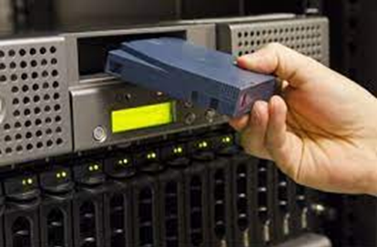
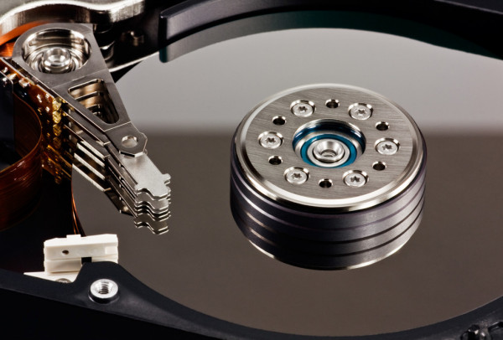
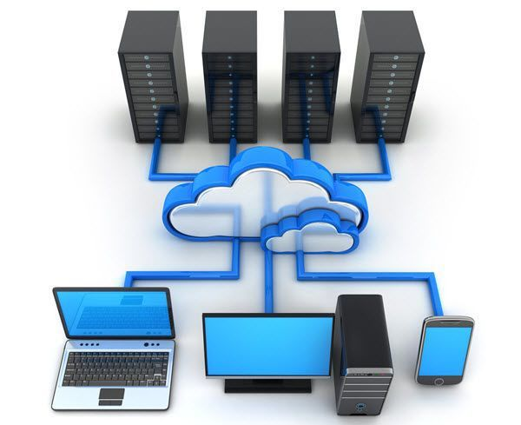
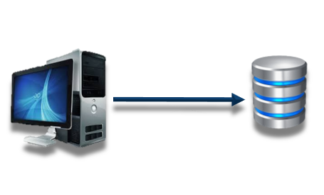
2.5 Given a scenario, implement cybersecurity resilience
Backup Media
Magnetic tape
Sequential storage
100 GB to multiple terabytes per cartridge
Easy to ship and store
Disk
Faster than magnetic tape
Deduplication and compression
Lack enterprise-level capacity and manageability
Cloud
Backup to a remote device in the cloud
Support many devices
May be limited by bandwidth
Image
Capture an exactly replica of everything on a storage drive
Restore everything on a partition, including
operating system files and user documents
Snapshot
Virtual machine backup

Slide 44





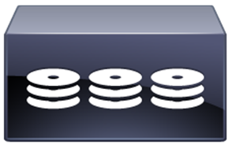
2.5 Given a scenario, implement cybersecurity resilience
Backup Media
Network-attached storage (NAS) vs Storage Area Network (SAN)
Clients
Clients
Ethernet Switch
Ethernet Switch
NAS Storage
Server
FC Switch
Server
Server
RAID
RAID
RAID

Slide 45
2.5 Given a scenario, implement cybersecurity resilience
Backup Media
Network-attached storage (NAS) vs Storage Area Network (SAN)
 | NAS | SAN
Data Processing | File level data | Block level data
Storage Identification | Appears shared folder | Appears as attached storage
Data Transmission: | Ethernet | Fiber Channel
I/O Protocol | NFS, SMB/CIFS, HTTP | SCSI, iSCSI, FCoE
Utilize virtualization | No | Yes - Cloud providers store cloud data on a SAN
Storage size | Store over 5 TB | Vast amount of storage
Deduplication | Yes | Yes
Information Sharing | Shared storage over shared network | Shared storage over dedicated network
Notes:
British Airways' data center problems make a good example of why order of restoration is a critical topic (computerweekly.com/news/450420405/The-British-Airways-IT-outage-What-went-wrong-with-its-datacentre).

Slide 46
Restoration Order
Power delivery systems
Switch infrastructure then routing appliances and systems
Network security appliances
Critical network servers
Backend and middleware and verify data integrity
Front-end applications
Client workstations and devices and client browser access
Notes:
British Airways' data center problems make a good example of why order of restoration is a critical topic (computerweekly.com/news/450420405/The-British-Airways-IT-outage-What-went-wrong-with-its-datacentre).

Slide 47
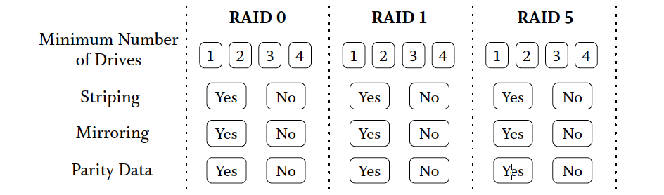
Answer the questions…
A file server has a full backup performed each Monday at 1 AM. Incremental backups are performed at 1 AM on Tuesday, Wednesday, Thursday, and Friday. The system administrator needs to perform a full recovery of the file server on Thursday afternoon. How many backup sets would be required to complete the recovery?
2
3
4
1
2. Select the values associated with the following RAID specifications:
Notes:
Answers
1. The Answer: C. 4
Each incremental backup will archive all of the files that have changed
since the last full or incremental backup. To complete this full restore, the
administrator will need the full backup from Monday and the incremental
backups from Tuesday, Wednesday, and Thursday.
The incorrect answers:
A. 2
If the daily backup was differential, the administrator would only need the
full backup and the differential backup from Thursday.
B. 3
Since the incremental backup only archives files that have changed, he will
need all three daily incremental backups as well as Monday’s full backup.
D. 1
To recover incremental backups, you’ll need the full backup and all
incremental backups since the full backup.
2. RAID 0: 2, yes, no, no
RAID 1: 2, no, yes, no
RAID 5: 3, yes, no, yes

Slide 48
QUESTIONS?

Slide 49
Risk, Operations & Resiliency
5.4 Summarize risk management processes and concepts
2.5 Given a scenario, implement cybersecurity resilience

